Slide 1


DESIGN AND DEVELOPMENT OF AN OFFLINE-FIRST EDGE-IoT SYSTEM FOR COLD CHAIN RISK MONITORING AND SAFE HOLDOVER TIME PREDICTION
DEPARTMENT OF ELECTRONICS ENGINEERING
MIT CAMPUS, ANNA UNIVERSITY
PROJECT WORK I
Presented by: Under the guidance of :
BARANITHARAN S (2025610033) Dr. P. T. V. BHUVANESWARI
M.E., Communication and Networking Professor and Head,
Dept of Electronics Engineering,
Madras Institute of Technology,
Anna University.

Slide 2

CONTENTS
Objective
Market Reach
Concepts
Proposed Methodology
Block Diagram and Flow Chart
Feature Comparison and Budget
Web Dashboard
Hardware 3D Model
Workplan and Review Workflow
References
FIRST REVIEW

Slide 3
OBJECTIVE
To design and develop a low-cost, offline-first IoT system that continuously monitors pharmaceutical cold-storage units and detects risks such as power failure, prolonged door opening, abnormal temperature rise, excessive compressor cycling, low backup battery and communication loss.
To develop and validate an edge-based thermal prediction model that estimates Safe Holdover Time, generates prioritized local and remote alerts before the product unsafe temperature limit also maintains reliable records during power or network failures and automatically synchronises the stored information after connectivity is restored.

Slide 4
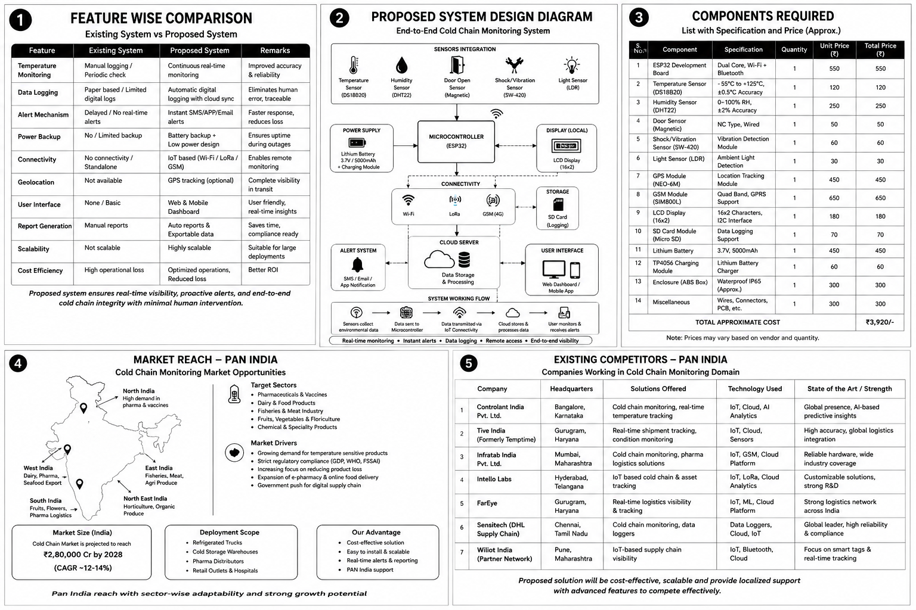
MARKET REACH

Slide 5
COLD-CHAIN MANAGEMENT
Cold-chain management is the controlled storage and transportation of temperature-sensitive products such as vaccines, medicines, and biological products.
It ensures that products remain within their required temperature range from the point of storage to the point of use.
Temperature excursions can reduce product quality, safety, and effectiveness, even when the excursion occurs for a short period.
Conventional monitoring may depend on manual inspection or continuous Internet connectivity, leading to delayed alerts or gaps in monitoring data.

Slide 6
VACCINE MANAGEMENT
Vaccines – +2 °C to +8 °C
Temperature Integrity: Vaccines should be continuously monitored and maintained within the prescribed temperature range throughout storage and transportation.
Excursion & Traceability: For Reliable Vaccine safety and traceability, Vaccine temperature excursions should be detected, generate alerts, and maintain timestamped records for efficient utilization.

Slide 7
SAFE HOLDOVER TIME PREDICTION
The estimated time remaining before the product-simulation temperature reaches a configured unsafe limit under the existing refrigerator or transport-box condition.
Safe Holdover Time = Remaining temperature margin ÷ (Estimated temperature - rise rate)
(or)
SHT = (Tlimit − Tproduct) / (dT/dt)
Where:
SHT = Estimated Safe Holdover Time
Tlimit = Configured upper-temperature limit
Tproduct = Present product-simulation temperature
dT/dt = Estimated temperature-rise rate

Slide 8
PROPOSED METHODOLOGY
Offline Database + SHT Prediction
Sensors collect temperature data; the ESP32 performs local threshold-based analysis, alert generation, and data logging.
Data is stored locally during offline conditions and automatically synchronized to the cloud/server when connectivity is restored.
The system therefore combines real-time monitoring, edge-based decision making, local data logging, alerts, and delayed cloud synchronization into a single cold-chain management framework.
20-Aug-26
FIRST REVIEW

Slide 9
BLOCK DIAGRAM
Compressor Current Sensor
Compressor ON/OFF Cycles
DS18B20 Probe 1
Air Temp
DS3231 RTC
Accurate Timestamp
OLED Display
Temp, status, & SHT
DS18B20 Probe 2
Product-Sim Temp
STORE AND FORWARD SYSTEM
Synchronization after reconnection
SHT31 Sensor
Humidity
ESP32 CONTROLLER
MicroSD Module
Offline Storage
Buzzer / LED
Local Alarm
Magnetic Reed Switch
Door Open/Closed
Communication Module
Wi-Fi / BLE / LoRa / GSM
Gateway / Dashboard
Graphs & audit logs
Isolated Mains Detector
Power Availability
Battery-Voltage Monitoring
Mobile / SMS Alert

Slide 10
FLOW CHART
Data-Acquisition Stage
Risk-Analysis Stage
Prediction Stage
Alert Stage
Offline Synchronisation Stage

Slide 11
FEATURE WISE COMPARISON
Feature | Existing System | Proposed System | Remarks
Temperature Monitoring | Manual checking / periodic data logging | Continuous real-time monitoring | Faster detection of temperature excursions
Data Logging | Paper-based / limited digital records | Automatic digital data logging | Reduces human error and provides traceability
Alert Mechanism | Delayed or manual response | Instant SMS/App/Email alerts | Enables corrective action before vaccine damage
Power Backup | Limited/no monitoring during power loss | Rechargeable battery backup | Maintains monitoring during outages
Connectivity | Standalone operation | Wi-Fi / GSM / LoRa connectivity | Enables remote supervision
Location Tracking | Generally unavailable | GPS-based tracking | Provides visibility during transportation
User Interface | Basic/no centralized interface | Web/mobile dashboard | Live status, history and alerts
Reports | Manual preparation | Automatic reports | Supports documentation and compliance
Scalability | Device-level monitoring | Multi-box / fleet-level monitoring | Suitable for large deployments
Cost Efficiency | Higher operational loss due to delayed detection | Low-cost IoT architecture | Reduces wastage and monitoring effort

Slide 12
BUDGET
Estimated Prototype Cost: ₹10,000–₹12,000
Component | Specification | Quantity | Approx. Price
ESP32 | Dual-core, Wi-Fi + Bluetooth | 2 | ₹800–1100
DS18B20 | −55°C to +125°C, digital temperature sensor | 2 | ₹60–120
SHT31 | Humidity Sensor | 1 | ₹200–250
DS3231 RTC | Clock Module | 1 | ₹300-350
Buzzer | 3.3 – 5V | 1 | ₹80-100
Magnetic Door Sensor | Reed switch | 1 | ₹30–50
Vibration Sensor | SW-420 / accelerometer | 2 | ₹50–100
LDR | Light detection | 1 | ₹20–30
NEO-6M GPS | GPS/GNSS receiver | 1 | ₹250–450
SIM800L | GSM/GPRS communication | 1 | ₹350–500
OLED/LCD | 0.96″ OLED / 16×2 LCD | 1 | ₹160–300
Micro-SD Module + Card | Local data logging | 1 | ₹200–300
Vaccine Carrier Box | Storage Unit – 2 Icepacks – 0.80 L | 1 | ₹1250
Foam Wrap for Vials | 2mm EPE | 1 | ₹329

Slide 13
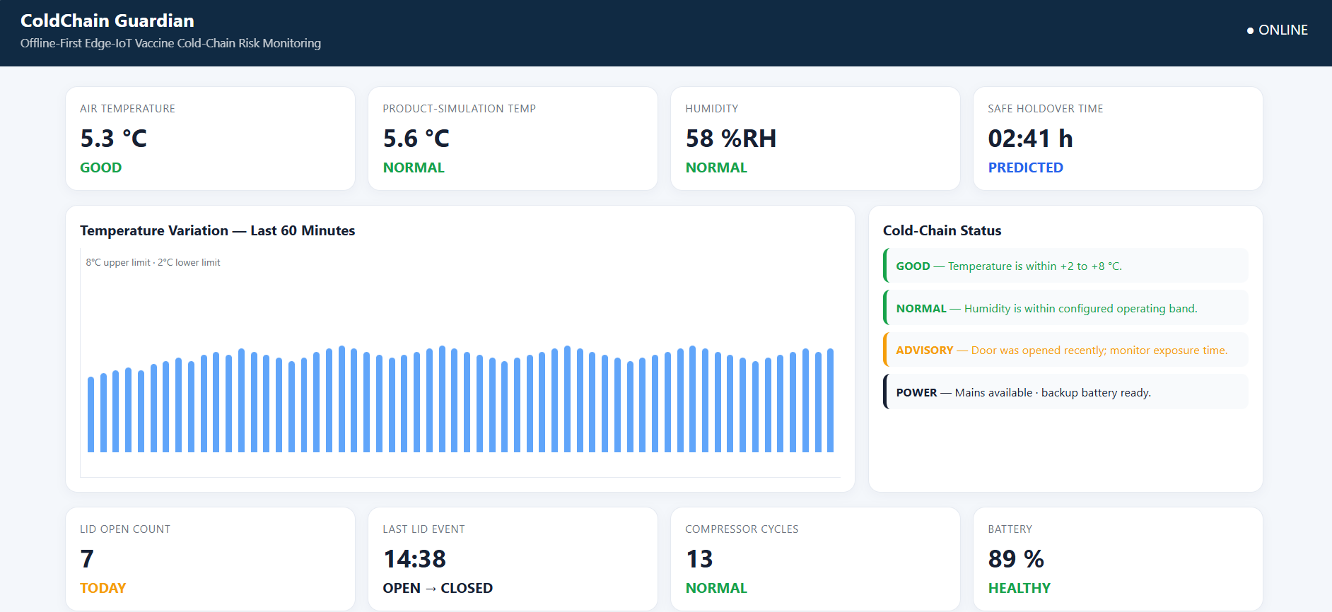
WEB DASHBOARD
ColdChain Guardian — Edge-IoT Dashboard

Slide 14
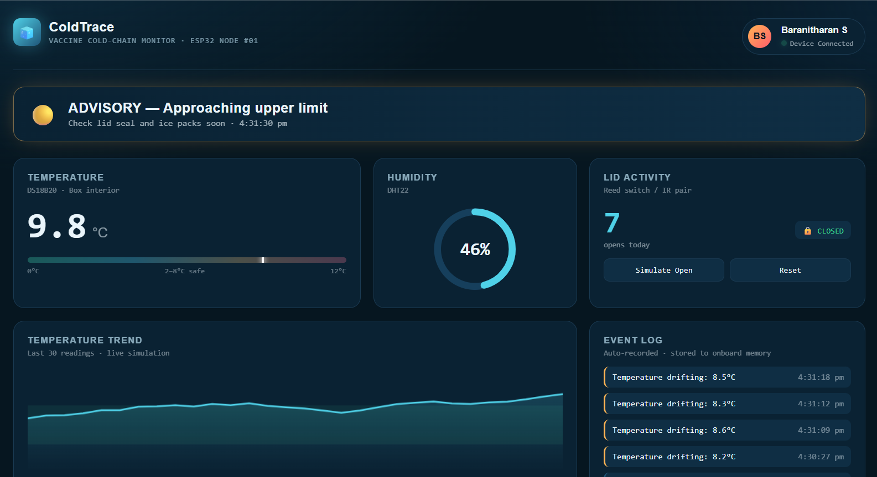
WEB DASHBOARD - MOBILE
ColdTrace — Vaccine Cold Chain Monitor

Slide 15
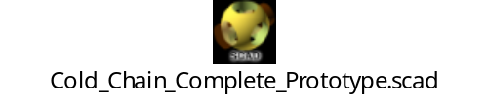
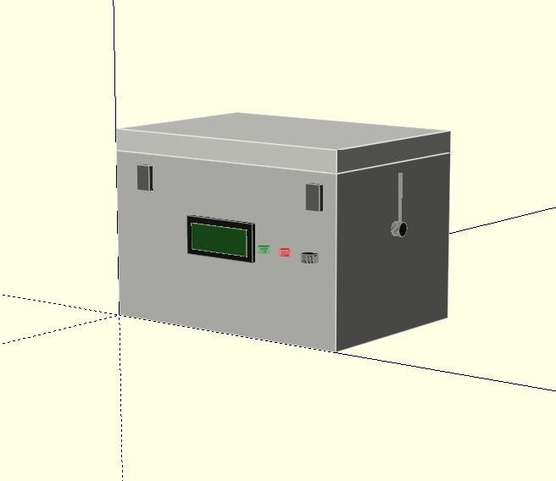
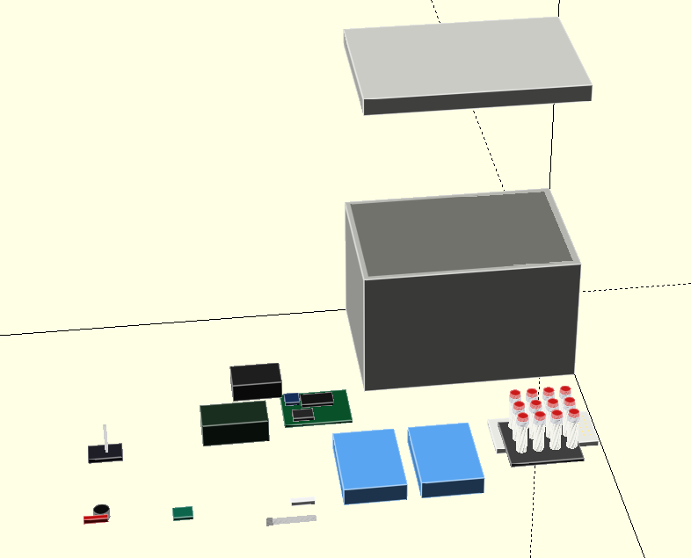
HARDWARE 3D MODEL

Slide 16
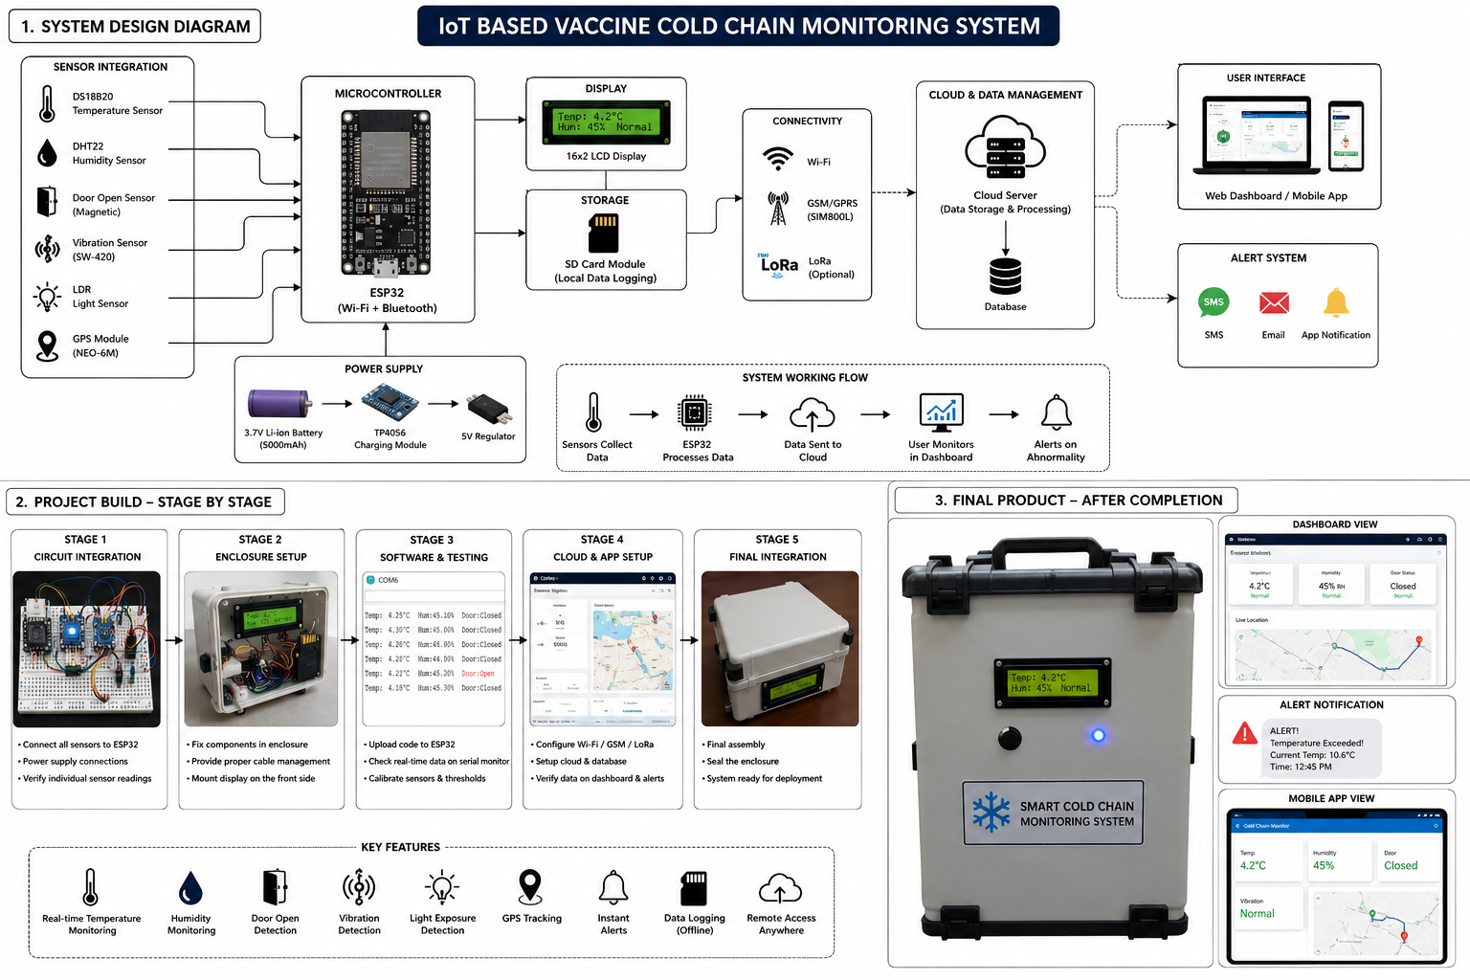
WORKPLAN

Slide 17
WORK FLOW
Review | Work to be Done
Review 1 | Conceptual Analysis, Simulation Design and Budget Framework
Review 2 | System Design, Offline IOT and Prediction Development
Review 3 | Complete Integration and Validation

Slide 18
REFERENCES
[1] N. A. Pambudi, A. Sarifudin, I. M. Gandidi and R. Romadhon, “Vaccine Cold Chain Management and Cold Storage Technology to Address the Challenges of Vaccination Programs,” Energy Reports, vol. 8, pp. 955–972, 2022.
[2] P. Badia-Melis, U. Mc Carthy, L. Ruiz-Garcia, J. Garcia-Hierro and J. I. R. Villalba, “New Trends in Cold Chain Monitoring Applications—A Review,” Food Control, vol. 86, pp. 170–182, 2018.
[3] Y. P. Tsang, K. L. Choy, C. H. Wu, G. T. S. Ho, H. Y. Lam and P. S. Koo, “An Internet of Things-Based Risk Monitoring System for Managing Cold Supply Chain Risks,” Industrial Management & Data Systems, vol. 118, no. 7, pp. 1432–1462, 2018.
[4] D. M. Matthias, J. Robertson, M. M. Garrison, S. Newland and C. Nelson, “Freezing Temperatures in the Vaccine Cold Chain: A Systematic Literature Review,” Vaccine, vol. 25, no. 20, pp. 3980–3986, 2007.
[5] U. Kartoglu and J. Milstien, “Tools and Approaches to Ensure Quality of Vaccines Throughout the Cold Chain,” Expert Review of Vaccines, vol. 13, no. 7, pp. 843–854, 2014.

Slide 19
REFERENCES(Cntd.)
[6] C. M. Hanson et al., “Is Freezing in the Vaccine Cold Chain an Ongoing Issue? A Literature Review,” Vaccine, vol. 35, no. 17, 2017.
[7] J. Lloyd and J. Cheyne, “The Origins of the Vaccine Cold Chain and a Glimpse of the Future,” Vaccine, vol. 35, no. 17, pp. 2115–2120, 2017.
[8] O. S. Kumru, S. B. Joshi, D. E. Smith, C. R. Middaugh, T. Prusik and D. B. Volkin, “Vaccine Instability in the Cold Chain: Mechanisms, Analysis and Formulation Strategies,” Biologicals, vol. 42, no. 5, pp. 237–259, 2014.
[9] World Health Organization, Immunization in Practice: A Practical Guide for Health Staff, 2015.
[10] World Health Organization, How to Monitor Temperatures in the Vaccine Supply Chain, Vaccine Management Handbook, 2015.

Slide 20
THANK YOU

